Slide 1
REGULAR EXPRESSIONS

Slide 2
What is Regular Expression in Python?
A Regular Expression (RE) in a programming language is a special text string used for describing a search pattern. It is extremely useful for extracting information from text such as code, files, log, spreadsheets or even documents.

Slide 3
Expression can include
Text matching
Repetition
Branching
Pattern-composition etc.

Slide 4
Regular Expression(RE) Syntax
“^”: This expression matches the start of a string
“w+“: This expression matches the alphanumeric character in the string
Here we will see a Python RegEx Example of how we can use w+ and ^ expression in our code. We cover the function re.findall() in Python, later in this tutorial but for a while we simply focus on \w+ and \^ expression.

Slide 5
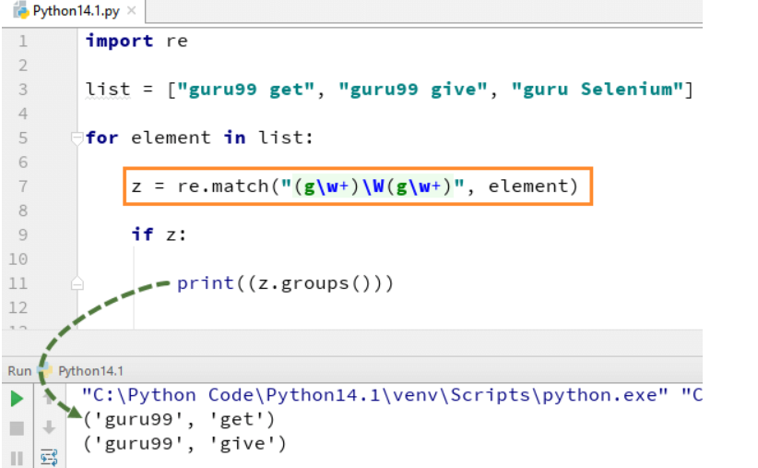
Example - match

Slide 6
search
re.search() function will search the regular expression pattern and return the first occurrence. Unlike Python re.match(), it will check all lines of the input string. The Python re.search() function returns a match object when the pattern is found and “null” if the pattern is not found

Slide 7
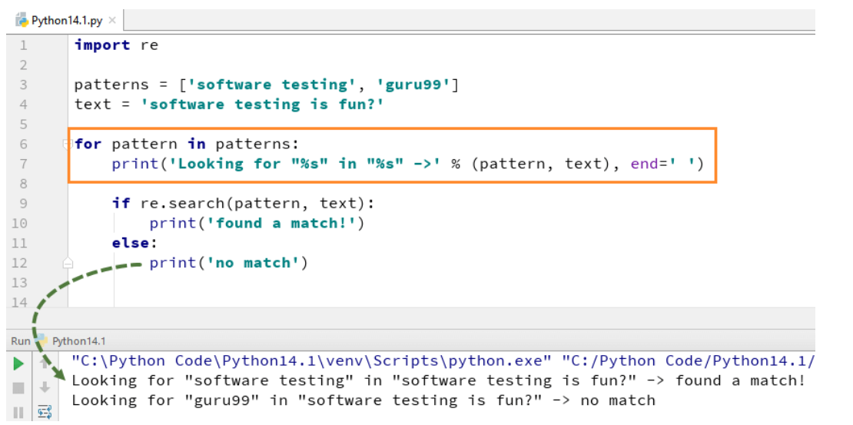

Slide 8
findall
Here we have a list of e-mail addresses, and we want all the e-mail addresses to be fetched out from the list, we use the method re.findall() in Python. It will find all the e-mail addresses from the list.

Slide 9
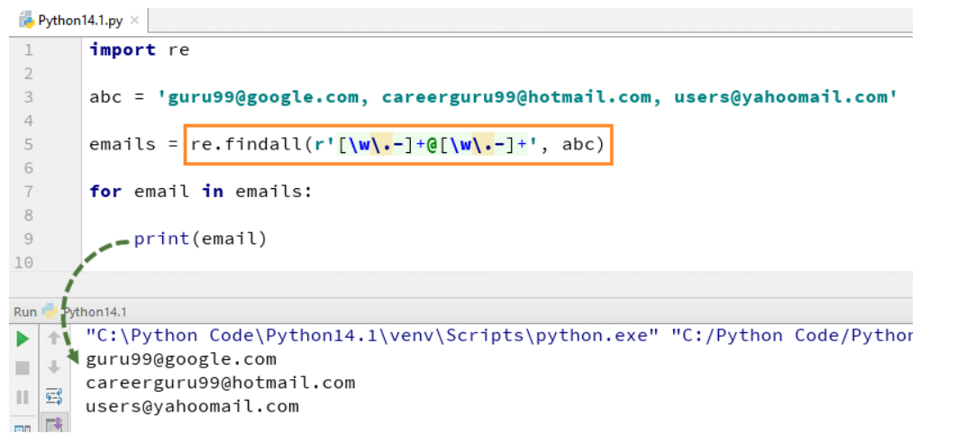

Slide 10
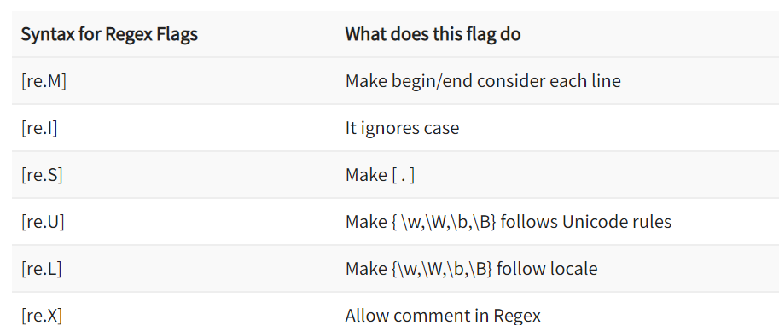

Slide 11
Multiline Flag
In multiline the pattern character [^] match the first character of the string and the beginning of each line (following immediately after the each newline). While expression small “w” is used to mark the space with characters. When you run the code the first variable “k1” only prints out the character ‘g’ for word guru99, while when you add multiline flag, it fetches out first characters of all the elements in the string.

Slide 12
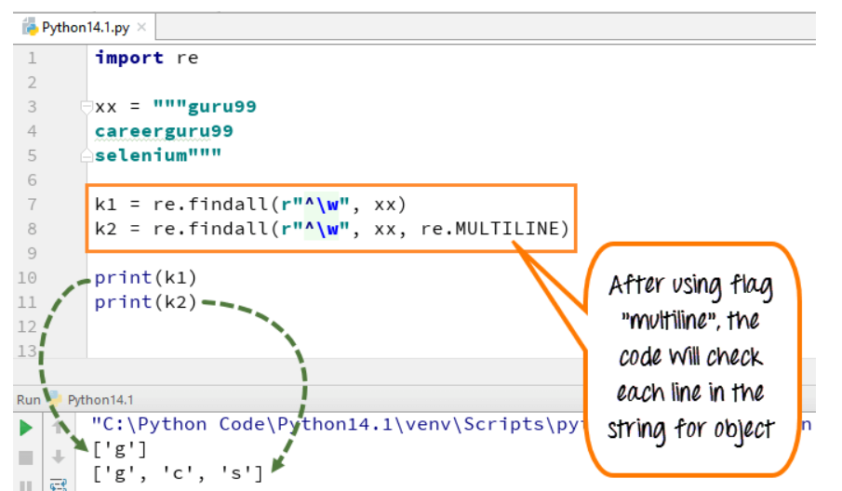

Slide 13
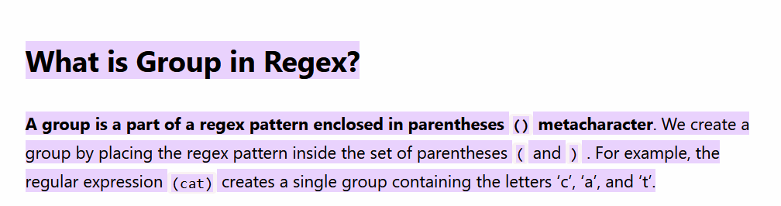

Slide 14
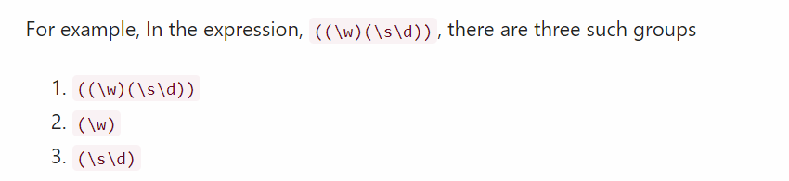

Slide 15
Example
target_string = "The price of PINEAPPLE ice cream is 20“
And, you wanted to match the following two regex groups inside a string
To match an UPPERCASE word
To match a number

Slide 16
To extract the uppercase word and number from the target string we must first write two regular expression patterns.
Pattern to match the uppercase word (PINEAPPLE)
Pattern to match the number (20).

Slide 17
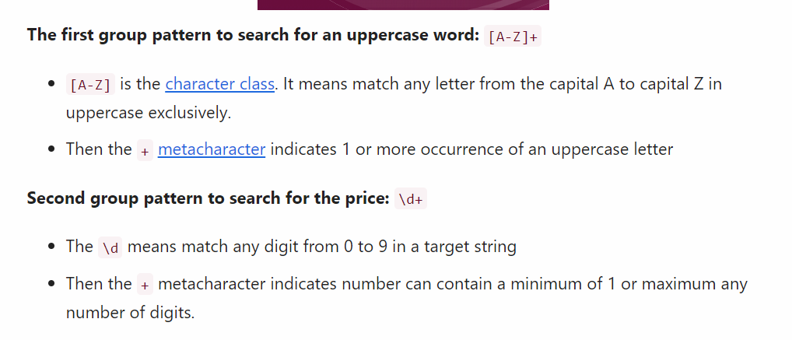

Slide 18
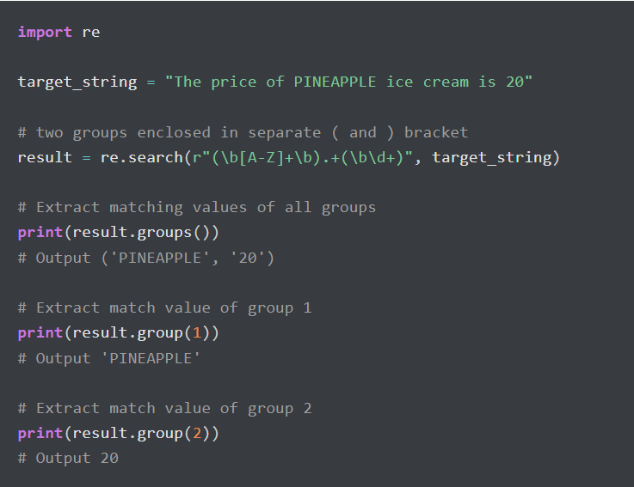

Slide 19
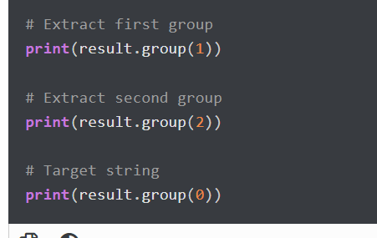
The groups() method
At last, using the groups() method of a Match object, we can extract all the group matches at once. It provides all matches in the tuple format.

Slide 20
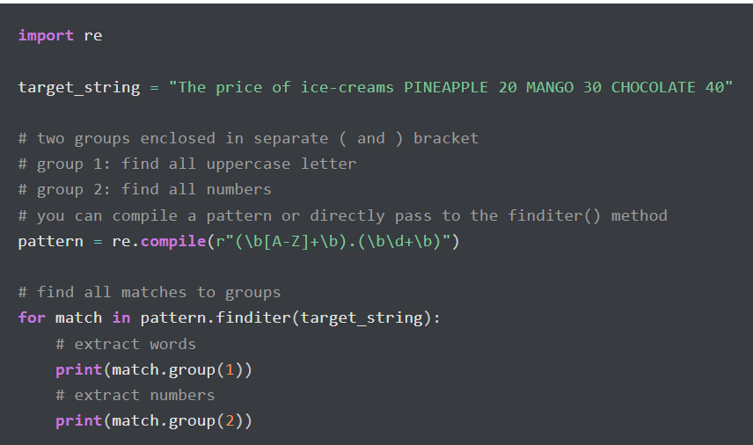

Slide 21
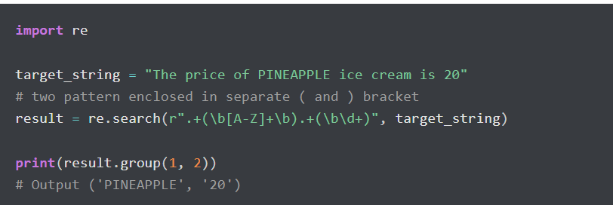
Extract Range of Groups Matches

